Slide 1
DO NOW
Dialysis is used for people whose kidneys have failed. Their blood is passed through a haemodialysis tube which contains very small hollow fibres made from a partially permeable membrane. The membrane blocks cells, platelets and large proteins but will allow solute molecules through. The dialysis fluid lacks substances such as urea, contains the same concentration of ions such as potassium and calcium and has the same amount of water as blood from a person who has functional kidneys.
State why the dialysis fluid has to be constantly replaced.
Explain why during some dialysis treatments calcium ions diffuse from the patient’s blood into the dialysis fluid but during others they diffuse from the dialysis fluid into the patient’s blood.

Slide 2
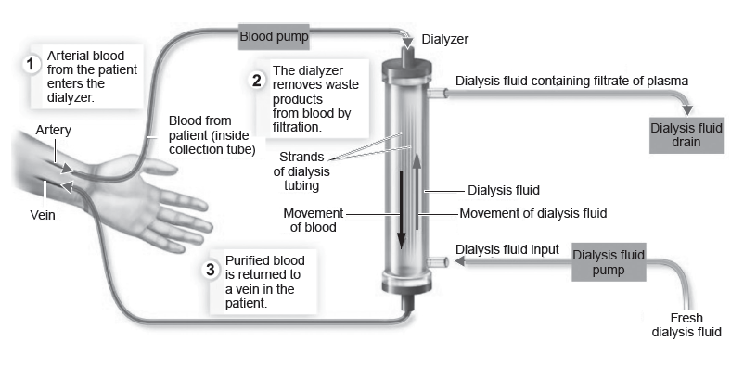

Slide 3


Slide 4
I know the function of the reproductive system
I have an idea what the male and female reproductive organs are.

Slide 5
Reproduction
The action or process of copying something.

Slide 6
Sexual
Relating to the two sexes.

Slide 7
Discharge
Discharge = to empty
To empty = discharge

Slide 8
I know the function of the reproductive system
I have an idea what the male and female reproductive organs are.
Making the connection
We know that organisms need to be able to reproduce and we might even know a bit about the reproductive system, but we need to understand how it works.
Reproduction is one of the characteristics of living things (MRS NERG).
Mitosis is the process of cell division that allows individual cells to reproduce (asexual reproduction)
Think, pair, share
Why do organisms need to reproduce?

Slide 9
I know the function of the reproductive system
I have an idea what the male and female reproductive organs are.
What does the reproductive system do?
The reproductive system is responsible for the functions involved in allowing organisms to reproduce, including producing male and female sex cells.
Males and females have different reproductive organs.

Slide 10
I know the function of the reproductive system
I have an idea what the male and female reproductive organs are.
What is a sex cell?
Why does a sex cell have half the amount of genetic information?
During sexual reproduction, two individuals produce offspring that have genetic characteristics from both parents.
Sex cells contain half the amount of genetic material that body cells contain.

Slide 11
I know the function of the reproductive system
I have an idea what the male and female reproductive organs are.
What is a sex cell?
Why does a sex cell have half the amount of genetic information?
The female sex cell is the ovum (egg)
The male sex cell is the sperm.
When an egg and sperm come together, the now fertilised egg contains a full set of chromosomes.

Slide 13
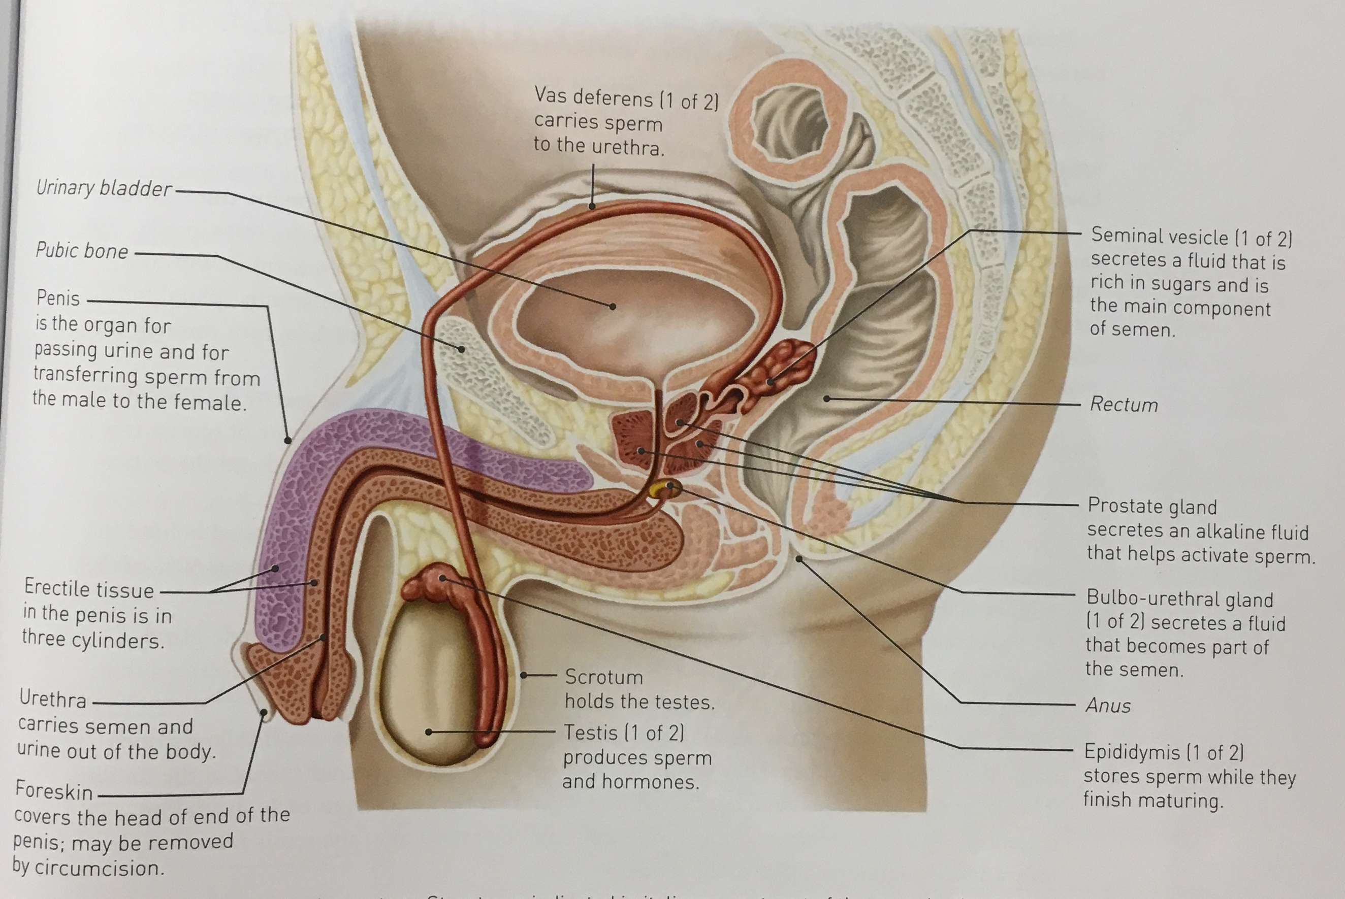
I know the function of the reproductive system
I have an idea what the male and female reproductive organs are.
What is a sex cell?
Why does a sex cell have half the amount of genetic information?

Slide 14
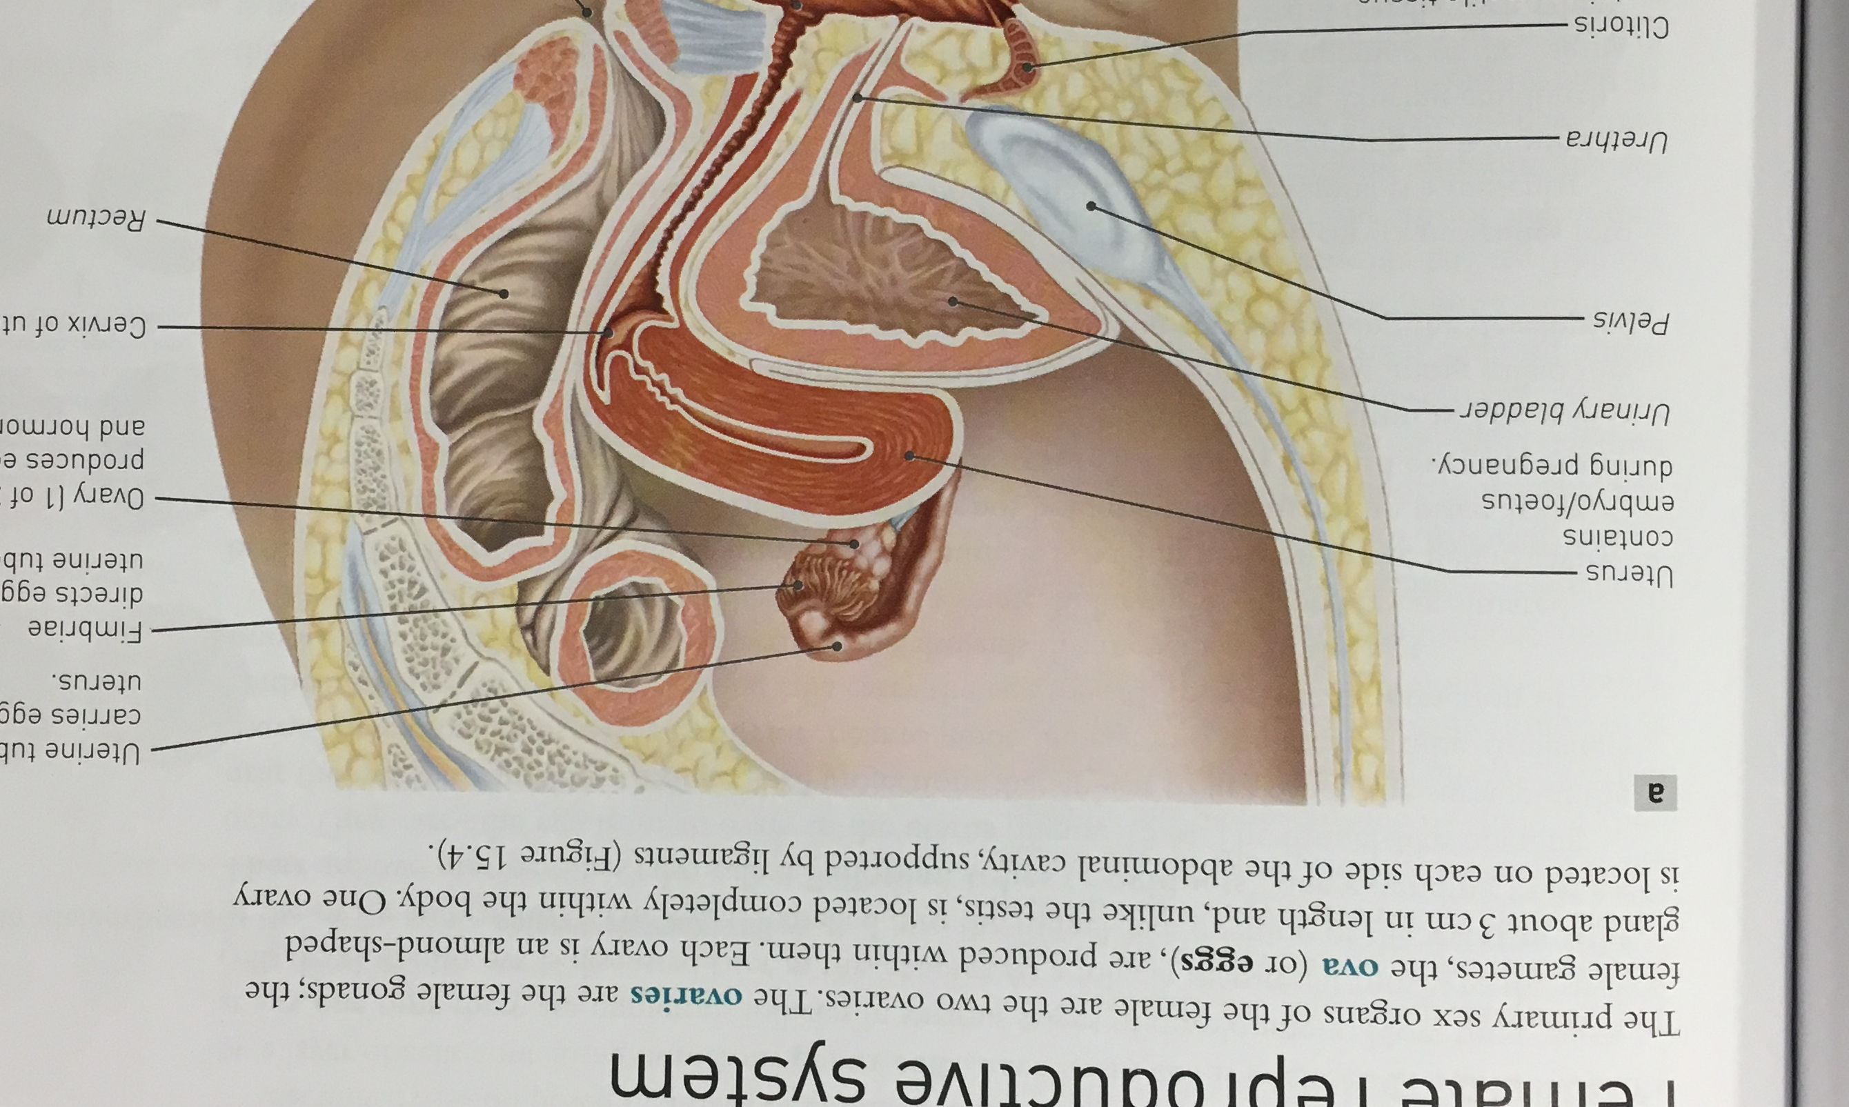
I know the function of the reproductive system
I have an idea what the male and female reproductive organs are.
What is a sex cell?
Why does a sex cell have half the amount of genetic information?

Slide 16
I know the function of the reproductive system
I have an idea what the male and female reproductive organs are.
Why is learning about the excretory system important?
We all have reproductive systems.
Of all of the body systems, you will probably be required to make the most decisions about your reproductive health.
Women’s reproductive systems are impacted significantly by contraceptives of all kinds, and understanding how they act is extremely important.
Notes:
2,000 British nationals including around a 1,000 men, to show where the vagina was in a diagram of the female reproductive system. About 50 percent of the men were clueless and could not do so. A further 61 percent could not identify a vulva.
In the poll, around 17 percent of the men did not know anything about gynecological health issues and further did not think they needed to know anything at all since it is a “woman thing”. Further 24 percent of the surveyed men did not feel comfortable talking to their female partners about their gynaecological health problems and issues.
They had found that 44 percent of the women did not know where the vagina was on the diagram.

Slide 17
I know the function of the reproductive system
I have an idea what the male and female reproductive organs are.

